Slide 1
Project :-
Provisioning and Post-provisioning Infrastructure using GCP
Team Members :-
Sanskar Singh - 12018117
Krish Desai - 12019847
Pragyan Dutta - 12016955

Slide 2
Project Overview :-
Creating Infrastructure :-
Learning various Services provided by Google Cloud Platform that are beneficial for the creation of the Infrastructure such as :-
Computing Services, Storage Services, Database Services, Monitoring, Identity and Security, Networking, etc.
Provisioning Infrastructure :-
Leverage Infrastructure as Code (IaC) tools like Terraform to automate the creation and configuration of GCP resources (VMs, Cloud Storage buckets, Cloud SQL instances, etc.).
Post Provisioning :-
Perform necessary configurations after resource creation, including:
Security group configuration (firewalls)
User access control setup
Software installation and configuration
Integration with other GCP services

Slide 3
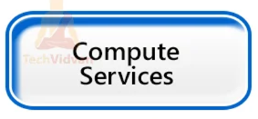
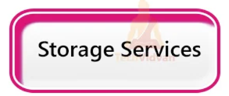

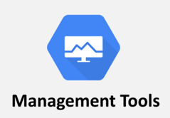
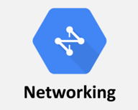
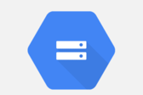
Team member Roles :-
Pragyan Dutta =>
Krish Desai =>
Sanskar Singh =>

Slide 4
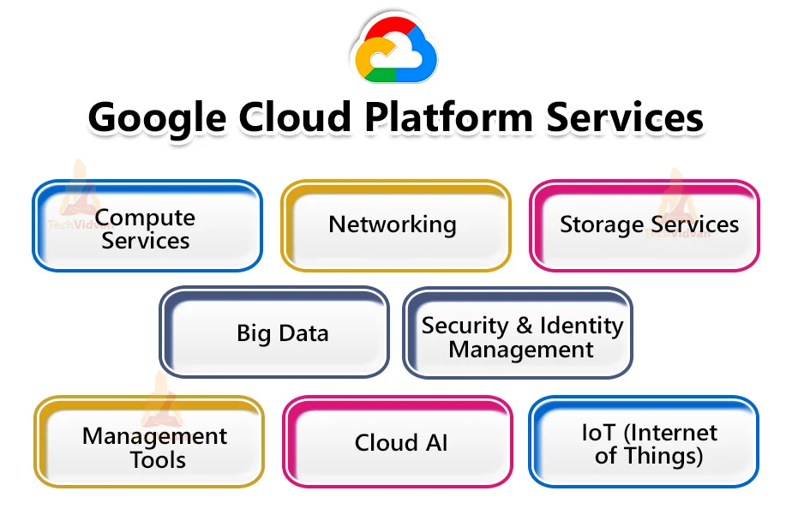

Slide 5
Compute Services :-
Compute Engine:-
It provides virtualized servers, replicating the functionalities of physical servers without the need for physical hardware management.
App Engine :-
App Engine is a fully managed, serverless platform for developing and hosting web applications at scale.
Sole Tenant Node :-
Sole Tenant Nodes offer a unique option for running your workloads on dedicated physical hardware.
Preemptible VMs :-
In GCP, preemptible VMs offer a cost-effective option for workloads that can tolerate interruptions.
Shielded VMs :-
Shielded VMs in GCP are a security-focused offering that provides enhanced protection for your virtual machines (VMs) against various threats like unauthorized access.

Slide 6
Storage Services :-
Cloud Storage(Bucket):-
Cloud Storage is a scalable object storage service offered by Google Cloud Platform (GCP).
File store:-
It is a managed file storage service offered by Google Cloud Platform (GCP).
Persistent Disk:-
It is a block storage service provides high-performance, durable, and scalable storage for virtual machines (VMs) running on Compute Engine.
Local SSD:-
It is a type of temporary, high-performance storage option available for virtual machines (VMs) running on Compute Engine in GCP.
Other Things:-
Versioning, Hoisting a static website on Cloud Storage, Attaching a persistent disk to the VM.

Slide 7
Database Services :-
Cloud Sql :-
It is a fully-managed relational database service offered by Google Cloud Platform (GCP). It allows you to set up, maintain, and manage MySQL, PostgreSQL, and SQL Server databases in the cloud, without the burden of managing underlying infrastructure.
Fire Store:-
It is a flexible, scalable NoSQL database service offered by Google Cloud Platform (GCP) and Firebase. It provides a document-oriented data model that excels in building real-time, offline-capable mobile, web, and server applications.
Cloud Spanner:-
Cloud Spanner is a fully managed, relational database service offered by Google Cloud Platform (GCP). It stands out for its unique combination of features, making it ideal for mission-critical applications

Slide 8
Monitoring Services :-
Cloud Monitoring:-
Cloud Monitoring is a comprehensive service within Google Cloud Platform (GCP) designed to monitor, analyze, and visualize the performance, health, and availability of your cloud resources.
Error Reporting:-
In Google Cloud Platform (GCP), Error Reporting serves as a vital tool for catching and managing errors within your running cloud services.
Cloud Logging:-
Cloud Logging is a managed service in Google Cloud Platform (GCP) that centralizes log data collection, storage, analysis, and monitoring.

Slide 9
Identity and Security :-
Cloud IAM:-
In Google Cloud Platform (GCP), Cloud Identity and Access Management (IAM) serves as the cornerstone for securing your cloud resources. It empowers you to meticulously control who (identity) has what level of access (permissions) to specific resources.
Virtual Private Cloud:-
A Virtual Private Cloud (VPC) within Google Cloud Platform (GCP) acts as a logically isolated network environment designed to provide you with secure and private connectivity for your cloud resources.
Cloud HSM:-
In Google Cloud Platform (GCP), Cloud HSM (Hardware Security Module) stands out as a service that provides secure storage and management of encryption keys..

Slide 10
Networking Services:-
Virtual Private Cloud :-
A Virtual Private Cloud (VPC) within Google Cloud Platform (GCP) acts as a logically isolated network environment designed to provide you with secure and private connectivity for your cloud resources.
Cloud Router:-
In Google Cloud Platform (GCP), Cloud Router functions as a fully managed service designed to provide dynamic routing between your VPC network (Virtual Private Cloud) and other networks.
Cloud Subnet:-
In Google Cloud Platform (GCP), Cloud Subnets reside within Virtual Private Clouds (VPCs) and function as logical subdivisions of your network. They offer a granular approach to managing IP addresses and enhancing security within your GCP environment.

Slide 11
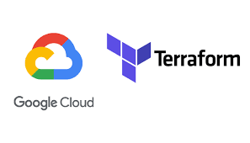
Terraform :-
About :-
Terraform is an open-source infrastructure as code (IaC) tool that simplifies the process of provisioning and managing infrastructure on various platforms, including Google Cloud Platform (GCP).

Slide 12
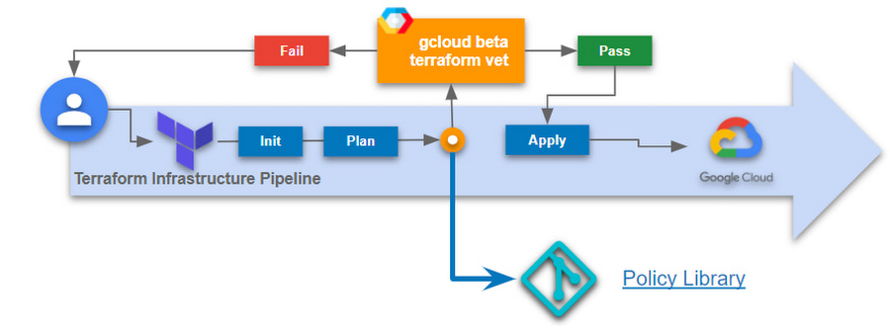
Terraform Configuration :-

Slide 13
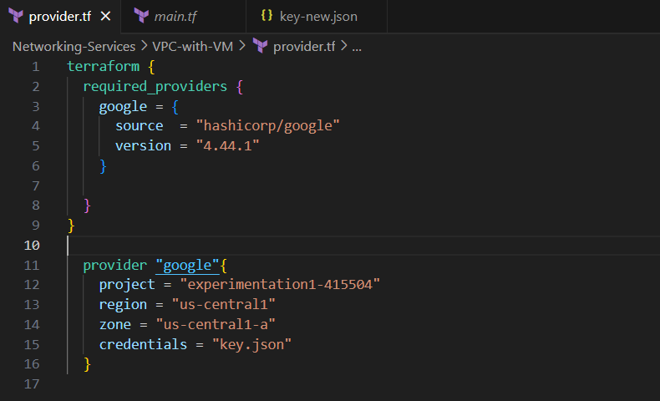
Components of a Terraform File :-
Provider.tf
The provider.tf file in Terraform acts as the control center for your GCP deployments, specifying how Terraform connects and interacts with your Google Cloud Platform resources.

Slide 14
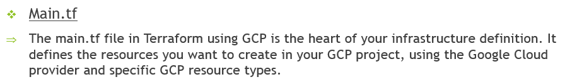
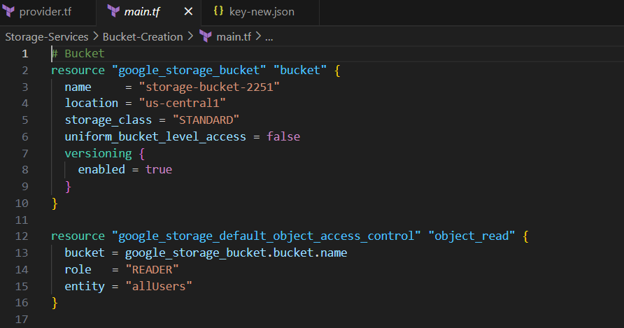
Components of a Terraform File :-

Slide 15
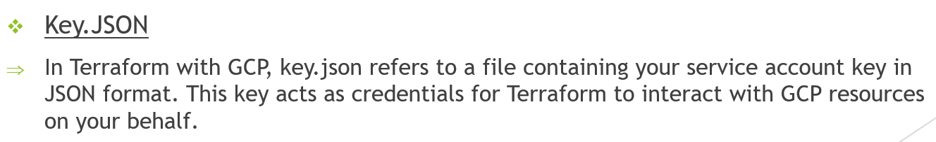
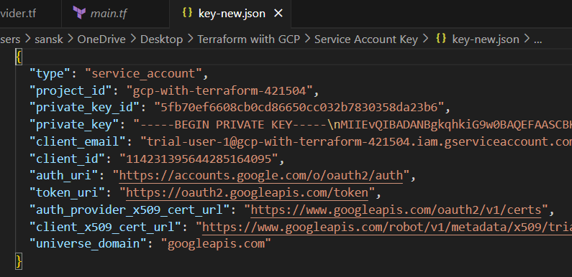
Components of a Terraform File :-

Slide 16
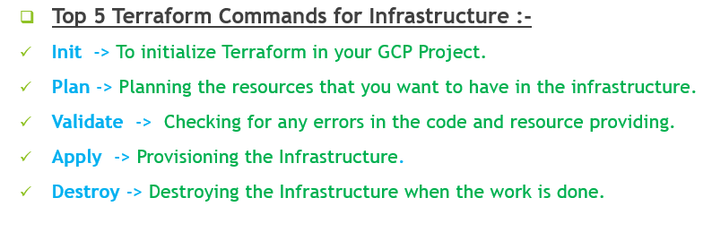

Slide 17
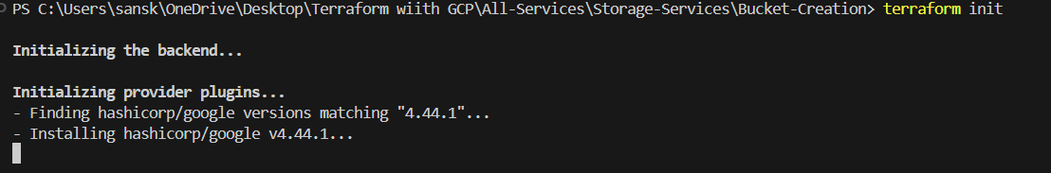
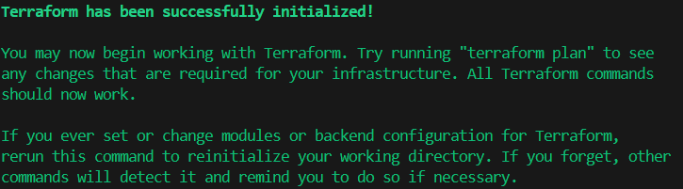
Init :-
Validate :-

Slide 18
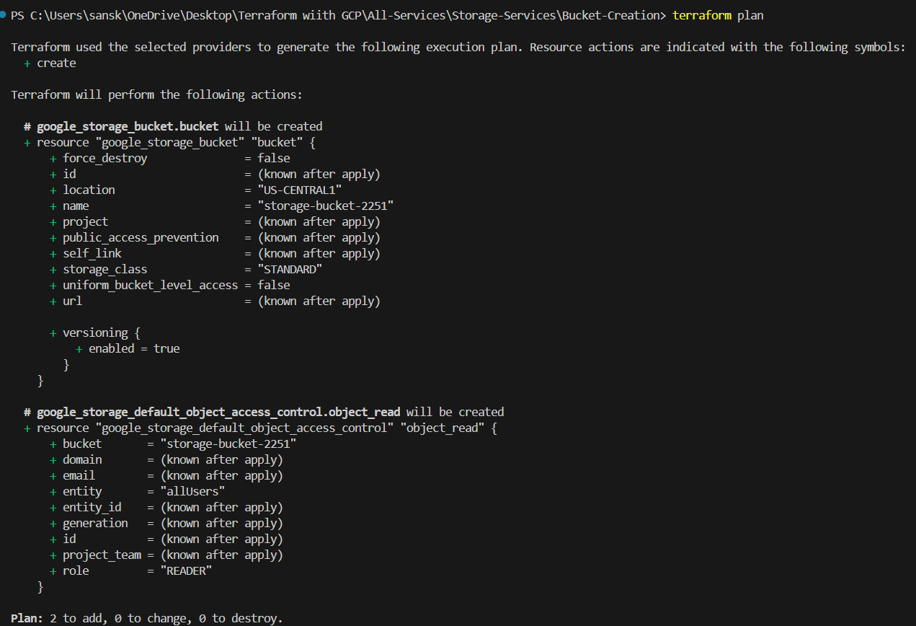
Plan:-

Slide 19
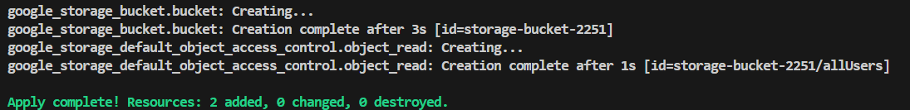
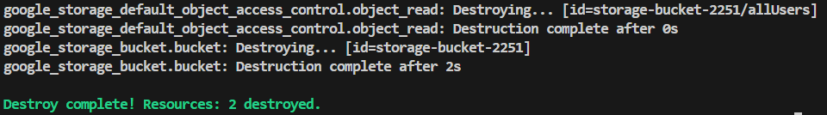
Apply :-
Destroy :-

Slide 20
Thank You

